Slide 1
UNIVERSITY OF HERTFORDSHIRE • PROJECT PRESENTATION
Effect of Digital Currency on Finance and Accounting: Challenges Associated with Taxation and Legislation in the UK
https://github.com/jakshirisha/Final-Project
Student Name : Shirisha Jakkula
Student ID : 23096388

Slide 2
Presentation Structure (Rubric Matrix)
1. Research Question
7. Model used
2. Background — prior work on this topic
8. Results of model implementation
3. Dataset
9. Hyperparameter tuning / parameter optimisation
4. Ethical soundness of the dataset
10. Interpretation of results
5. EDA plots
11. Summary & conclusions
6. Data pre-processing
12. References

Slide 3
1
Research Question
Main research question
How does digital currency affect finance and accounting practices in the UK, and what challenges are associated with taxation and legislation for cryptocurrencies and digital assets?
Q1
How do digital currencies influence UK finance and accounting practice?
Q2
What taxation challenges are associated with cryptoassets in the UK?
Q3
What are the major legislative and regulatory issues?
Q4
What risks and opportunities does adoption create for the sector?

Slide 4
2
Background
Accounting literature
Taxation literature
UK regulatory context
• Luo & Yu (2024): inconsistent GAAP/IFRS crypto reporting.
• Parrondo (2023): payment tokens → IAS 38; security tokens → IFRS 9.
• Lazea et al. (2024): no universal IFRS classification; audit risk.
• Baer et al. (2023): pseudonymity blocks enforcement.
• Bhullar et al. (2025): cross-country tax gaps drive evasion.
• Kicova et al. (2025): DeFi and taxable-event complexity.
• HMRC: crypto = property; CGT / Income Tax apply.
• CGT exemption cut to £3,000 (2024/25).
• FSMA 2023 brought crypto into the UK perimeter.
• Gaps remain for DeFi, stablecoins, cross-border tax.

Slide 5
3
What Is Your Dataset?
Mendeley Cryptocurrency Historical Dataset (Mahapatro, 2025) • CC BY 4.0 • https://data.mendeley.com/datasets/5tv4bmrrf8/2
File
Rows
Columns
After cleaning
Date range
BITCOIN24.csv
2,250
7
2,250
Jan 2018 – Feb 2024
ETHEREUM.csv
2,404
7
2,391
Jan 2018 – Jul 2024
LITECOIN24.csv
2,404
7
2,404
Jan 2018 – Jul 2024
Total raw rows
Columns each
Overlap days
Assets
7,058
7 (OHLCV)
2,250
BTC • ETH • LTC

Slide 6
4
How Is the Dataset Ethically Sound?
No personal data
No human subjects
Open licence
Market-level OHLCV only — no names, wallets, or individual records.
No surveys or interviews; UK GDPR not engaged for this dataset.
CC BY 4.0 permits documented academic reuse without fee.
Public sources
No consent risk
Transparent use
Aggregated exchange data via Elsevier/Mendeley repository.
No identifiable participants → no UH ethics approval required.
DOI cited; analysis limited to academic research aims.

Slide 7
5. Show EDA Plots
Exploratory Data Analysis from Bitcoin, Ethereum and Litecoin

Slide 8
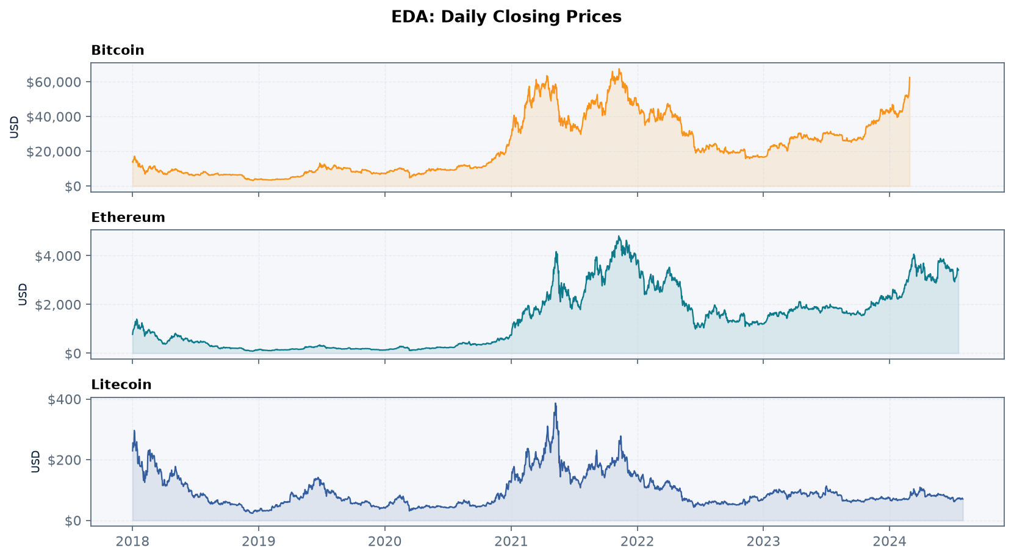
5
EDA Plot — Closing Price Trends
What this shows ?
• All three assets show large boom–bust cycles.
• Bitcoin ranged ~$3.2k to ~$67.5k.
• 2021 peak and 2022 crash are clear.
• EDA insight:
• Extreme price paths create fair-value and CGT difficulty.
UH Project Presentation | Rubric Matrix | 10–12 minutes

Slide 9
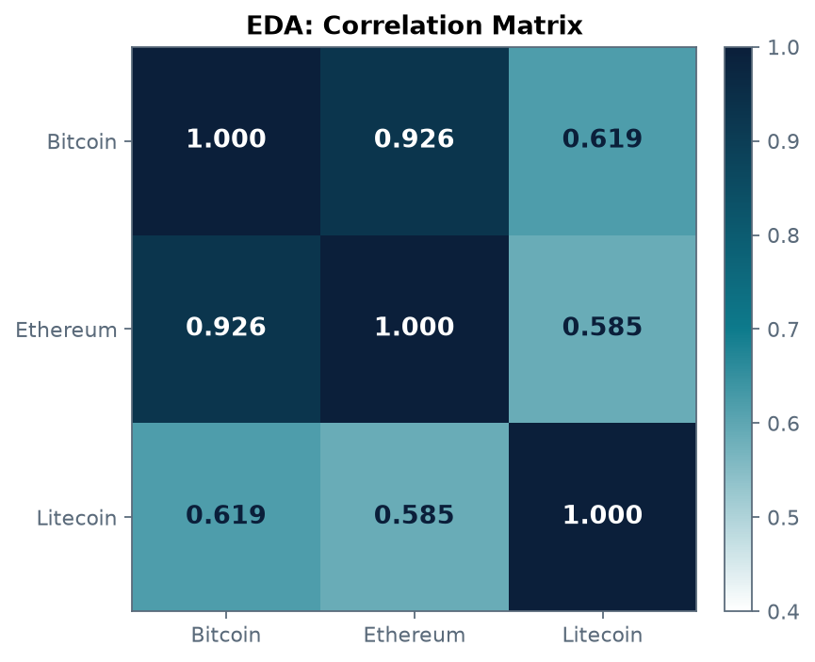
5
EDA Plot — Correlation
What this Graph shows ?
• BTC–ETH correlation ≈ 0.926 (very high).
• BTC–LTC ≈ 0.62; ETH–LTC ≈ 0.59.
• Litecoin is more independent.
• EDA insight:
• Assets can move together, but HMRC still requires separate CGT per asset.

Slide 10
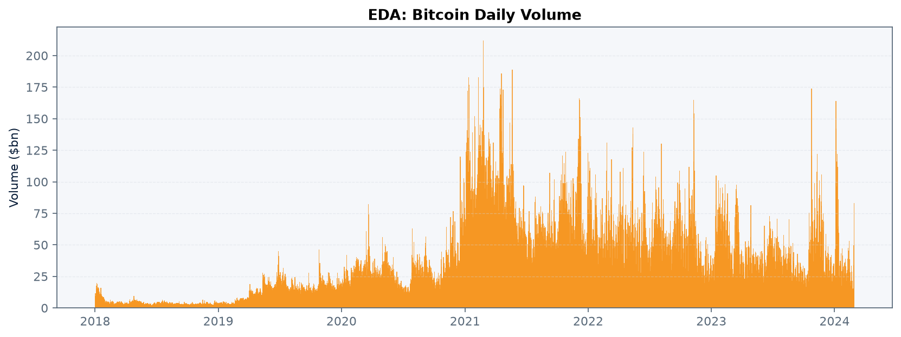
5
EDA Plot — Trading Volume
What this shows ?
• Volume spikes in 2021 and 2022.
• Higher volume ≈ denser trading activity.
• EDA insight:
• Peak activity periods are also peak taxable-disposal intensity.

Slide 11
6
Data Pre-processing ?
Yes — systematic five-step cleaning before analysis
1
Datetime conversion
2
Numeric coercion
3
Missing values
Date → datetime64; chronological sort/index.
ETH object/text prices → float (errors='coerce').
13 ETH null rows removed (end of sample).
4
Duplicates
5
Redundancy
Result
Analysis-ready sizes
Checked; none found in any file.
ETH Adj Close dropped (equals Close).
BTC 2,250 • ETH 2,391 • LTC 2,404 rows.

Slide 12
7
Explain the Model Used
Analytical / statistical model suite in Python (not a single black-box ML classifier)
Descriptive statistics
Pearson correlation
Risk model
Mean, std, min/max, skew, kurtosis of closing prices.
Co-movement of BTC, ETH, LTC over overlapping days.
Log returns → annualised volatility, Sharpe, max drawdown, VaR.
CGT simulation
Event study
Trend model (SMA)
Hypothetical UK holder; HMRC annual exempt amounts by tax year.
Price change ±30 days around FSMA 2023 and CGT cuts.
30-day and 90-day Simple Moving Averages on Bitcoin.

Slide 13
7
Why This Model Suite Suits the Problem
Matches research aim
RQ focuses on tax/accounting challenges driven by volatility and market behaviour — not price forecasting accuracy alone.
Transparent & auditable
Each step is explainable to finance/accounting audiences and markers (architecture is clear).
Direct UK link
CGT simulation and event windows map to HMRC rules and FSMA 2023.
Literature aligned
Uses methods consistent with crypto time-series work (e.g. volatility / SMA approaches in recent studies).
Train / evaluate style
Parameters fixed a priori, then evaluated on full cleaned sample with tables and plots.
Diagram of flow
CSV → clean → EDA → risk/CGT/SMA models → interpret against UK tax & IFRS gaps.

Slide 14
8. Results of Model Implementation
Key quantitative outputs

Slide 15
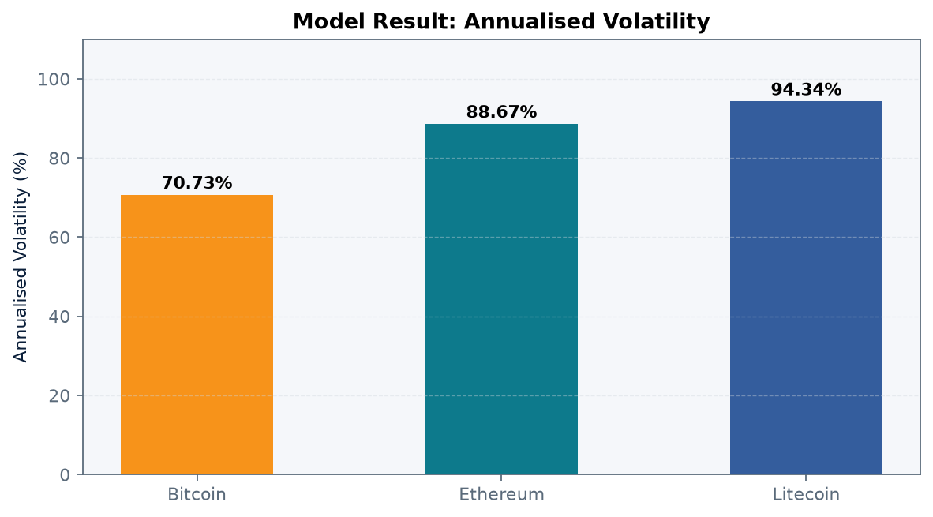
8
Results — Volatility & Correlation
Key results
• Annualised volatility:
• • Bitcoin 70.73%
• • Ethereum 88.67%
• • Litecoin 94.34%
• Correlation:
• • BTC–ETH r = 0.926
• • Supports high co-movement risk
• Implication: IAS 38-style fair value is unstable in practice.
UH Project Presentation | Rubric Matrix | 10–12 minutes

Slide 16
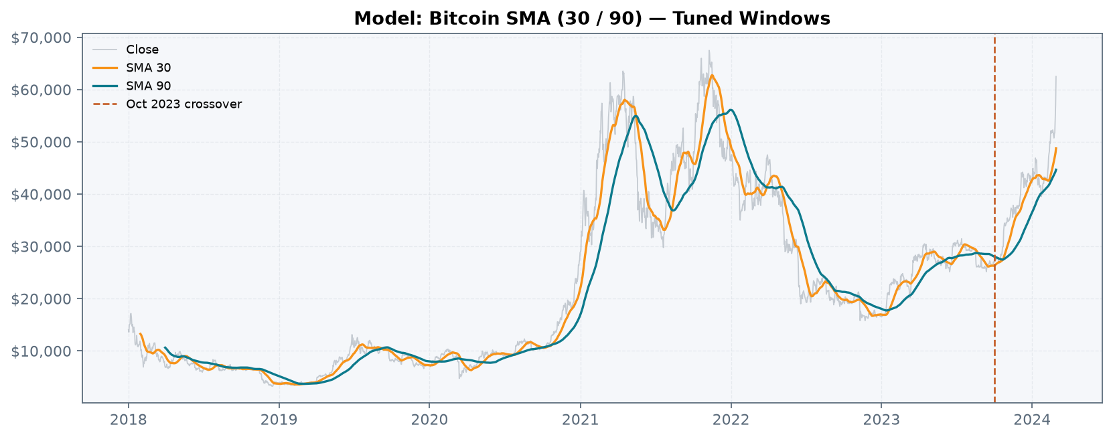
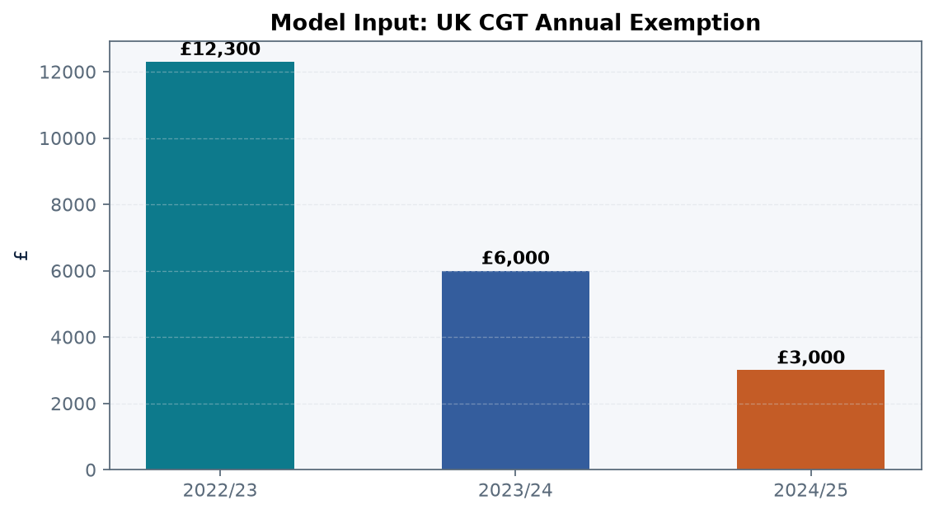
8
Results — SMA Trend & CGT Inputs
SMA result: bullish Bitcoin crossover from October 2023. | CGT result: exemption fall £12,300 → £3,000 raises taxable base in the simulation.

Slide 17
9
Hyperparameter Tuning / Parameter Optimisation
Parameters were selected and justified (not left as defaults without reason)
SMA windows
30-day & 90-day
Short vs medium trend; standard in market analysis; detects Oct 2023 crossover.
Volatility window
30-day rolling
Balances responsiveness vs noise for annualised volatility.
Event window
±30 days
Captures short-run market reaction to FSMA / CGT policy events.
CGT parameters
HMRC yearly exempt £
Used official amounts: £12,300 / £6,000 / £3,000 by tax year.
Correlation sample
2,250 overlap days
Only common dates — avoids mismatched series bias.
Return transform
Log returns
Stabilises relative price changes for risk metrics.

Slide 18
10
Interpretation of Results
For accounting (RQ1)
High volatility and skewed prices explain why crypto fair-value reporting under IFRS remains inconsistent and audit-risky.
For taxation (RQ2)
Volume spikes + lower CGT exemption mean more taxable events and harder compliance — self-reporting is stressed.
For legislation (RQ3)
Market scale and BTC–ETH co-movement show why FSMA 2023 alone is incomplete; CRAO/CARF will matter.
For practice (RQ4)
Risks are real (volatility, enforcement gaps), but opportunities exist in advisory, tooling, and clearer standards.
Advantage vs disadvantage
Efficiency/inclusion gains exist, yet 94.34% max annualised volatility and CGT attribution problems are material disadvantages.

Slide 19
11
Summary & Conclusions
Digital currency creates measurable pressure on UK finance and accounting through volatility, co-movement and tax complexity.
Dataset of 7,058 raw daily rows (BTC/ETH/LTC) was cleaned ethically from public CC BY 4.0 sources.
Models (risk metrics, correlation, CGT simulation, SMA, event windows) were suitable, parameterised and evaluated with plots/tables.
Results: volatility up to 94.34%; BTC–ETH r≈0.93; CGT exemption cut sharply increases taxable exposure.
Conclusion: clearer IFRS guidance, stronger HMRC/CARF data flows, and professional tooling are needed as CRAO approaches 2027.

Slide 20
12
References
1. Luo, M. and Yu, S. (2024). Financial reporting for cryptocurrency. Review of Accounting Studies, 29(2), pp.1707–1740.
2. Baer, K., De Mooij, R., Hebous, S. and Keen, M. (2023). Taxing cryptocurrencies. Oxford Review of Economic Policy, 39(3), pp.478–497.
3. FCA (2024). Research Note: Cryptoassets Consumer Research 2024 (Wave 5). London: Financial Conduct Authority.
4. HMRC (2024). Self Assessment Tax Returns: Cryptoasset Reporting Requirements 2024/25. London: HM Revenue and Customs.
5. Mahapatro, S. (2025). Cryptocurrency Dataset. Version 2. Mendeley Data. Available at: https://doi.org/10.17632/5tv4bmrrf8.2

Slide 21
Thank You
Questions Welcome

